Slide 1
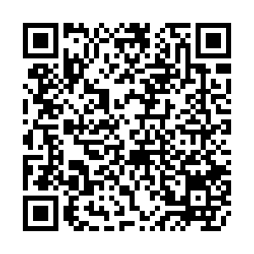
Lecture 02: Control
CS 61A SU26
June 23, 2026
Rebecca Dang
Join pollev.com/rebeccadang831 (or scan QR code) on your phone or laptop
We’ll begin at Berkeley time (10 minutes after), as per tradition!

Slide 2
Potpourri
Announcements
Askademia
Computing in the news
WWPD: Functions
5 min

Slide 3
Announcements
Lec 1 recording is up on bCourses > Media Gallery (last bit cut off, just read the slides)
Please use your @berkeley.edu email for accessing all course emails
  All share requests to external emails will be denied
If you need to be assigned a lab/disc section or reschedule due to an immovable time conflict, email cs61a@berkeley.edu ASAP
If you were in Esha's lab yesterday and lost your keys and/or Berkeley Bowl tote bag, retrieve it from the Soda Hall lost and found (3rd floor front desk, across from Soda 384) [Ed post]

Slide 4
Askademia
[new resource] Askademia: A Berkeley research project (paper) that allows students to ask questions during live and recorded lectures and it responds in-context
askademia.org/cs61a/su26
Video playlists linked on course website under each lecture (if applicable), roughly correspond to the YouTube playlists
As always, be careful about hallucinations or out of scope content
This semester's assignments/lectures/labs/discussions are the "canonical" scope

Slide 5
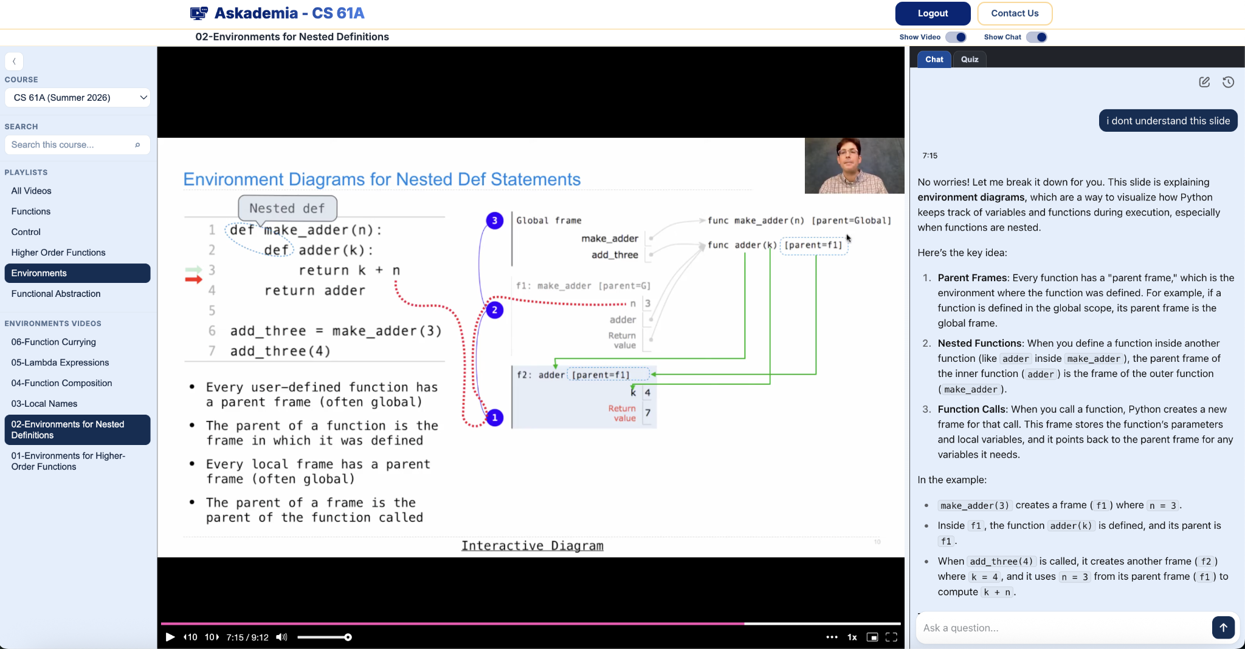
Askademia interface

Slide 6
Computing in the news
Yesterday: Google Invests $75 Million in A24 to Develop AI-Powered Filmmaking Tools (Variety)
A24 is a studio that has developed many critically acclaimed films, including Moonlight, Everything Everywhere All At Once, and most recently, Backrooms
DeepMind is a AI subsidiary of Google behind AlphaGo (AI Go player that beat one of the best human players) and AlphaFold (protein folding prediction, 2024 Nobel Prize in Chemistry)
Big contention in creative communities about the role of AI
  Should artists use AI to make or help them make art?
  How will this affect creative jobs? How ethical is it to use AI models trained on art without the artist's consent or compensating artists?
  Is AI capable of making art? What even is art?

Slide 7
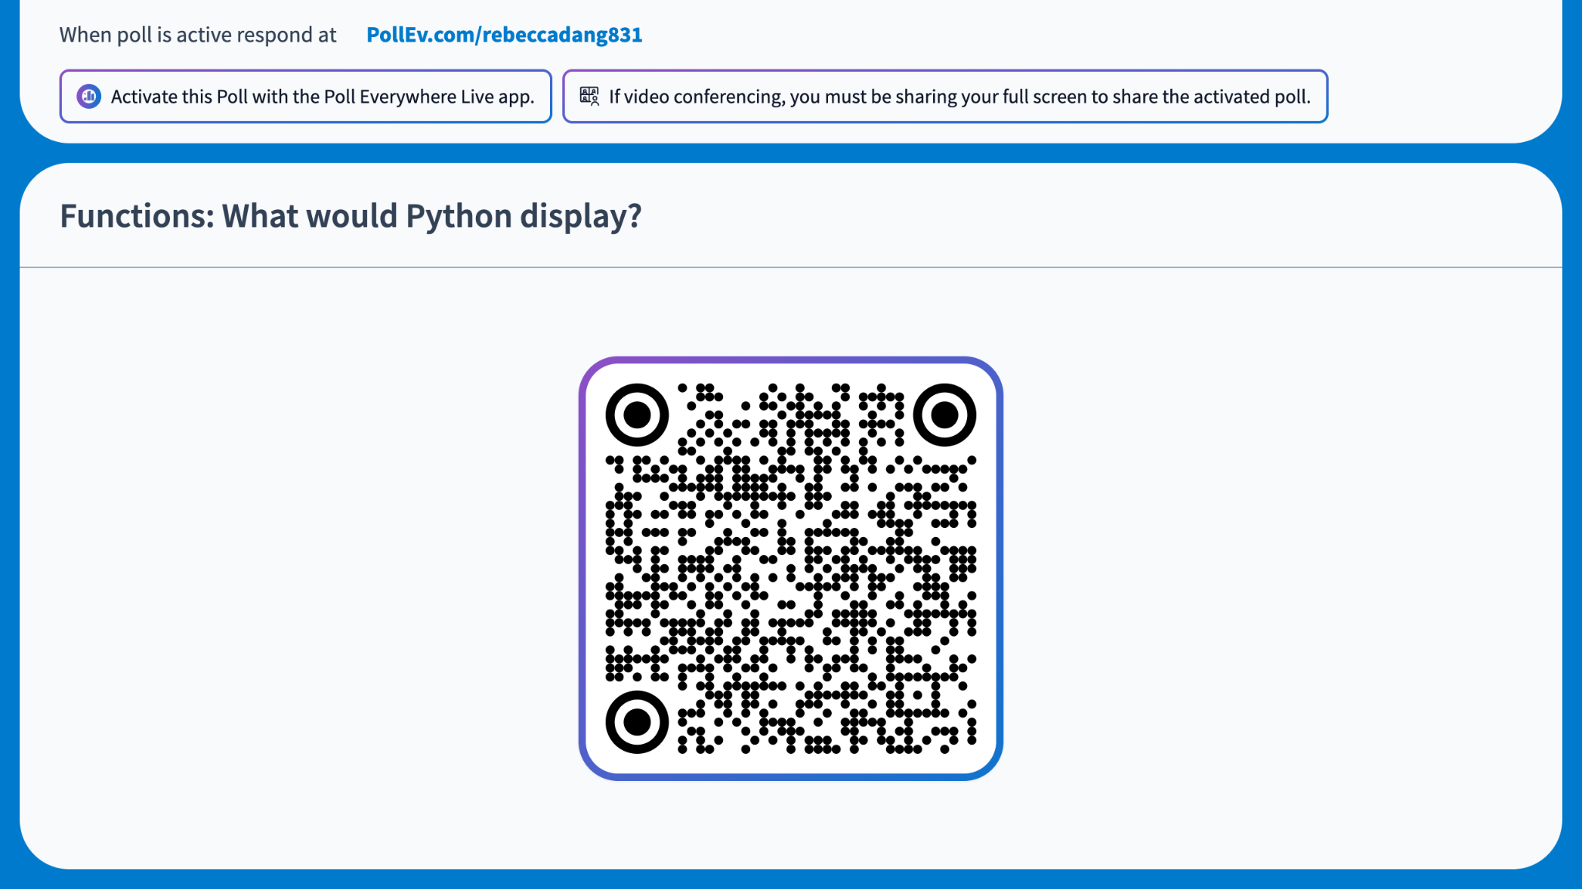
Notes:
https://PollEv.com/multiple_choice_polls/Wt3NEN5UB1SNAXyywZ2iX/respond
Functions: What would Python display?
>>> from operator import mul
>>> def square(square):
... return mul(square, square)
...
>>> square(3)
It would error
3
9
None
Answer: (c)

Slide 8
Boolean Expressions
Booleans
Truthy or Falsy
Boolean expressions
  Inequality operators
  Logical operators
Short circuiting
15 min

Slide 9
Booleans
Primitive data type that has only 2 possible values: True or False
We use it to represent truth values, aka "answers to yes or no questions"
  Is your age 18 or older?
  Have you done your homework and your chores?
  Is the light on?

Slide 10
Truthy and Falsy Values
In Python, all data types can behave like booleans, even if they aren't actually booleans!
Falsy values: False, 0, 0.0, None, or empty containers, such as an empty string ('')
  How to remember: "Falsy if it's zero or represents nothing"
Truthy values: Everything else

Slide 11
Boolean expressions
>>> age = 21
>>> age > 18
True
>>> age > 21
False
A boolean expression is an expression that evaluates to some truthy or falsy value
You can construct boolean expressions by combining values or names with operators
  Inequality operators: >, <, >=, <=, ==, !=
  Logical operators: and, or, not
>>> hw_done = True
>>> chores_done = False
>>> can_scroll = hw_done and chores_done
>>> can_scroll
False

Slide 12
and operator truth table: both must be T → T
 | T | F
T | T | F
F | F | F

Slide 13
or operator truth table: at least one must be T → T
 | T | F
T | T | T
F | T | F

Slide 14
not operator: flips the current value
not True → False
not False → True

Slide 15
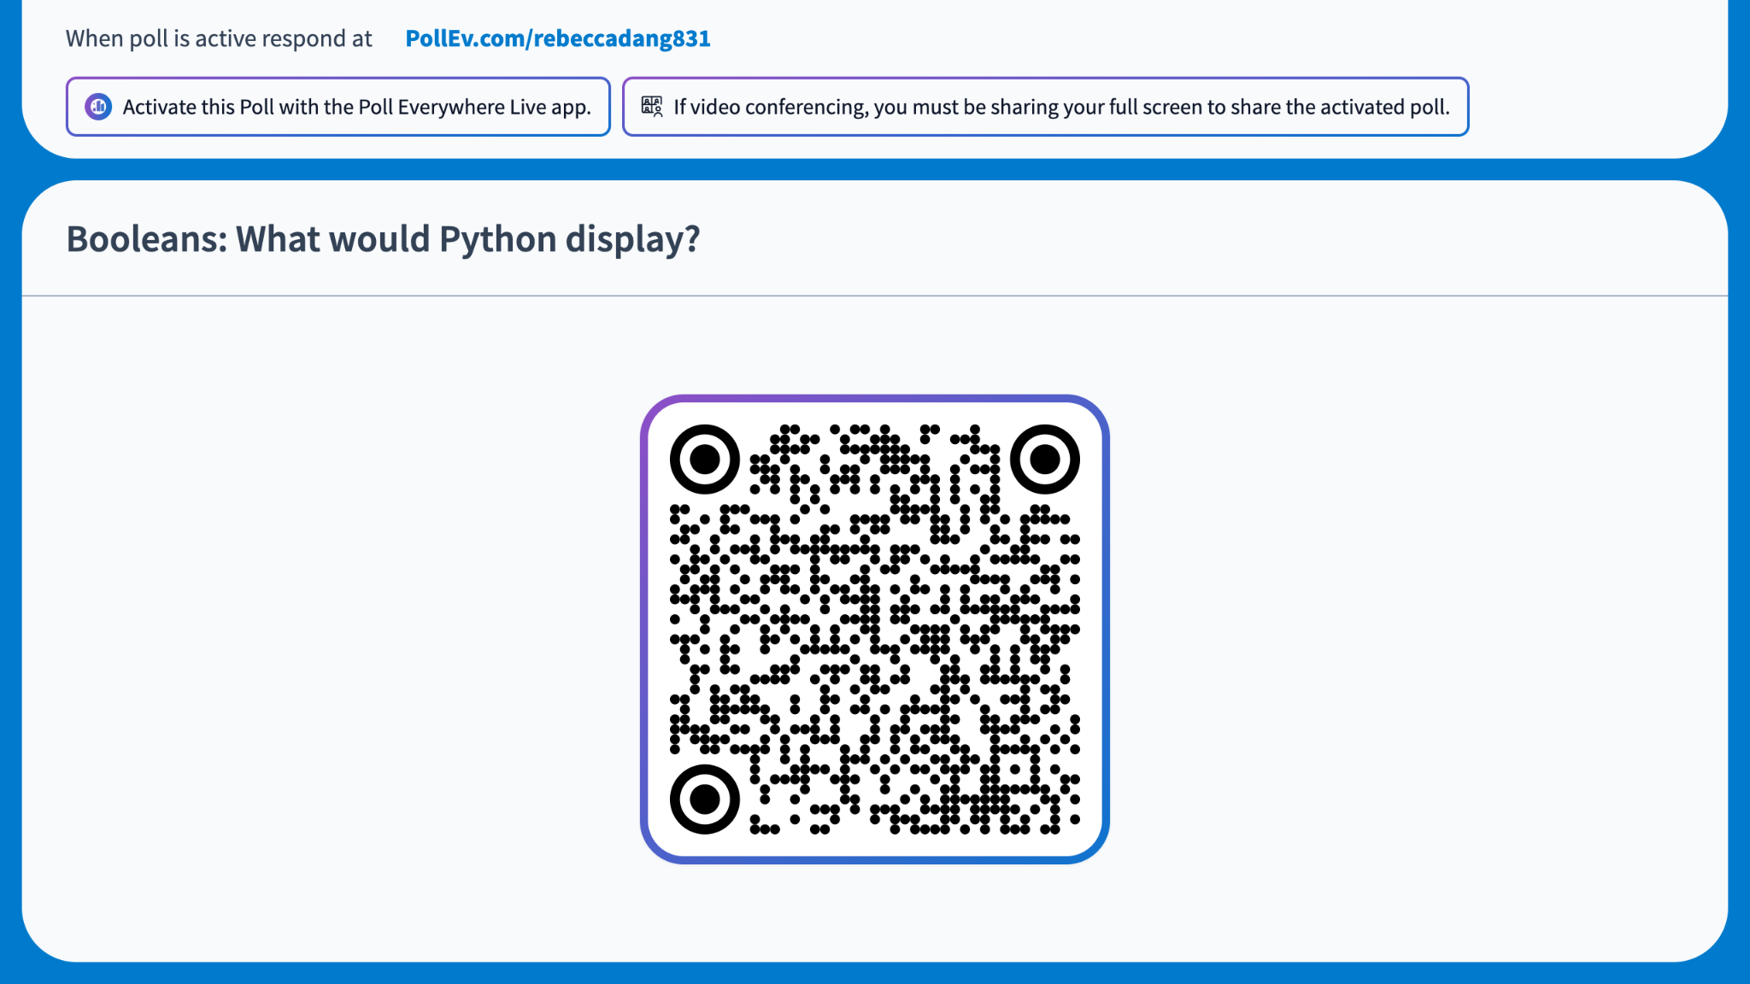
Notes:
https://PollEv.com/multiple_choice_polls/Vt1smfQRsfY3f2Jji0FsJ/respond
Booleans: What would Python display?
>>> 5 or (6 / 0) and not None
True
False
5
6
0
None
It would error
Correct: (c)

Slide 16
What just happened? Short circuiting!
Motivation: Python doesn't want to do more computation than is necessary to evaluate a boolean expression
  Exit early if needed
    and: Can stop after the first falsy value
    or: Can stop after the first truthy value
  The full expression evaluates to the "last looked at" value (not necessarily a boolean data type)
Another thing that was going on: Operator precedence
  If no parentheses provided, Python "groups together" not, then and, then or
5 or (6 / 0) and not None is equivalent to
5 or ((6 / 0) and (not None))

Slide 17
Conditional Statements
Statements
Conditional Statements (If-Elif-Else)
15 min

Slide 18
Statements
A statement is executed by the interpreter to perform an action
Compound
Statement
Clause
Suite
<header>:
<statement>
<statement>
...
<separating header>:
<statement>
<statement>
...
...
The header determines the statement type
The header of a clause "controls" the suite that follows
So far, we've only learned one compound statement: def statements

Slide 19
Conditional Statements
if <expression>:
<suite>
elif <expression>:
<suite>
else:
<suite>
Motivation: How can we only execute a set of statements (suite) under certain conditions?
  Ex: If the user is a TA, display the student roster. Else, hide the student roster page.
Solution: Conditional statements (aka if statements)

Slide 20
Example: absolute value
def absolute_value(x):
if x < 0:
return -x
elif x == 0:
return 0
else:
return x
(really, you should just use the built-in abs function)

Slide 21
Example: absolute value (simplified, logically equivalent)
def absolute_value(x):
if x < 0:
return -x
else:
return x
(elif and else are optional, and you can have multiple elif clauses!)

Slide 22
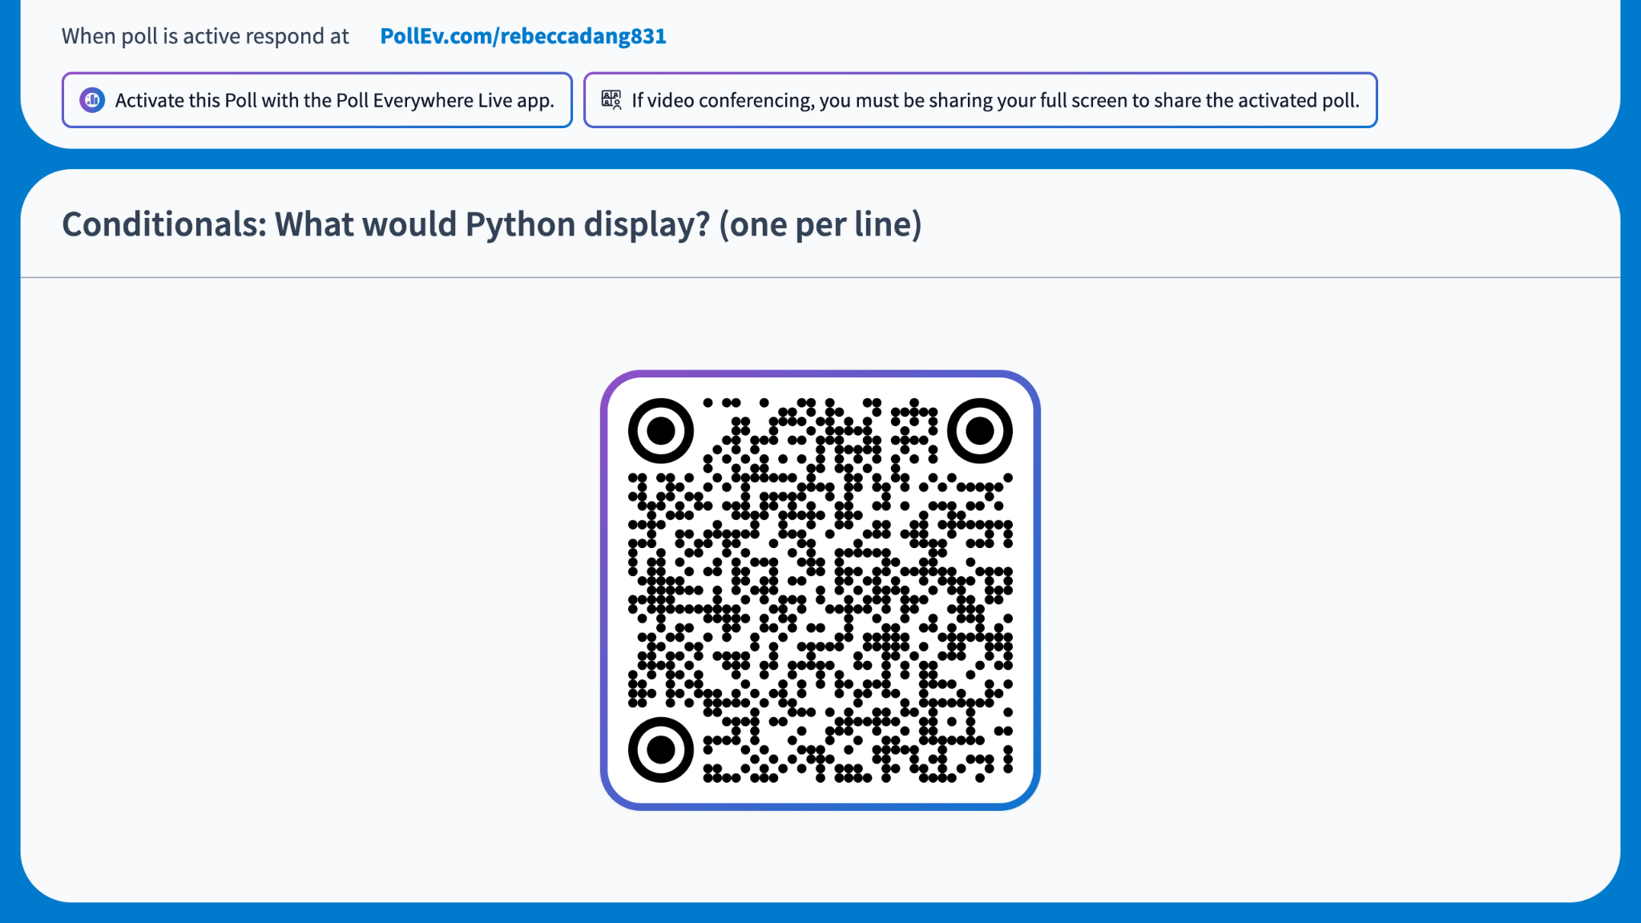
Notes:
https://PollEv.com/multiple_choice_polls/1PxL82jcqW1cnc88RcJYA/respond
Conditionals: What would Python display? (one per line)
>>> x = 10
>>> if x > 15:
... print("A")
... if x > 5:
... print("B")
... elif x > 7:
... print("C")
…
A
B
C
A, B
B, C
A, C
A, B, C
Answer: (b)

Slide 23
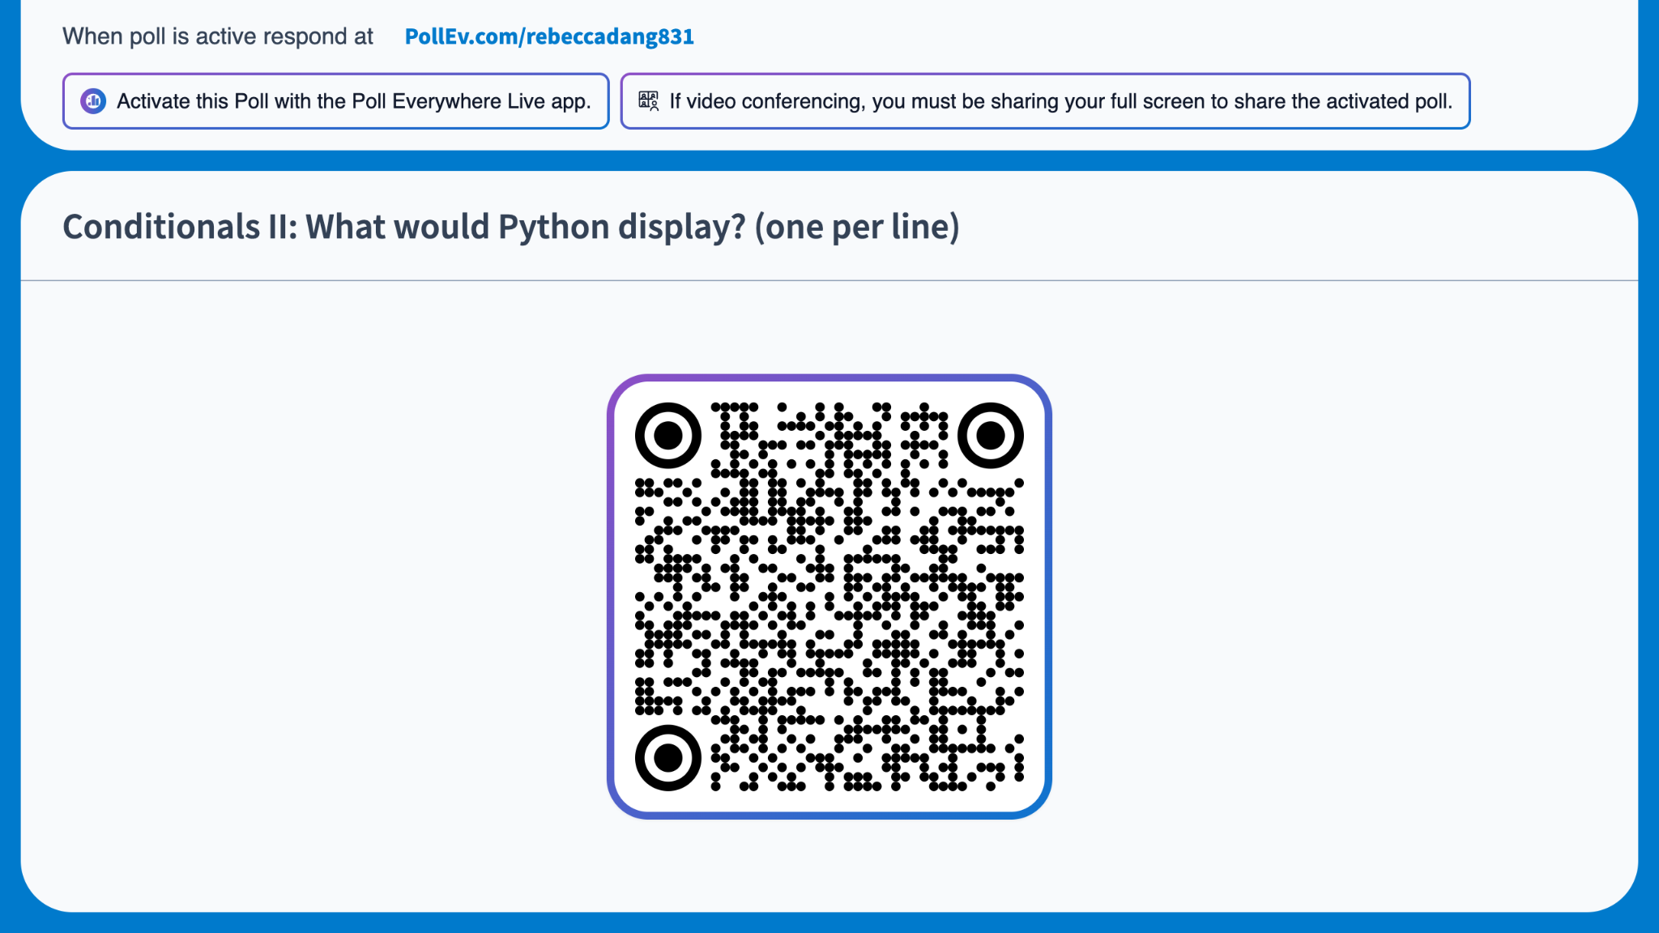
Notes:
https://PollEv.com/multiple_choice_polls/GrN57XVdGVs0NzW5qniiH/respond
Conditionals II: What would Python display? (one per line)
>>> x = 10
>>> if x > 9:
... print("A")
... if x > 5:
... print("B")
... elif x > 7:
... print("C")
...
A
B
C
A, B
B, C
A, C
A, B, C
Answer: (d)

Slide 24
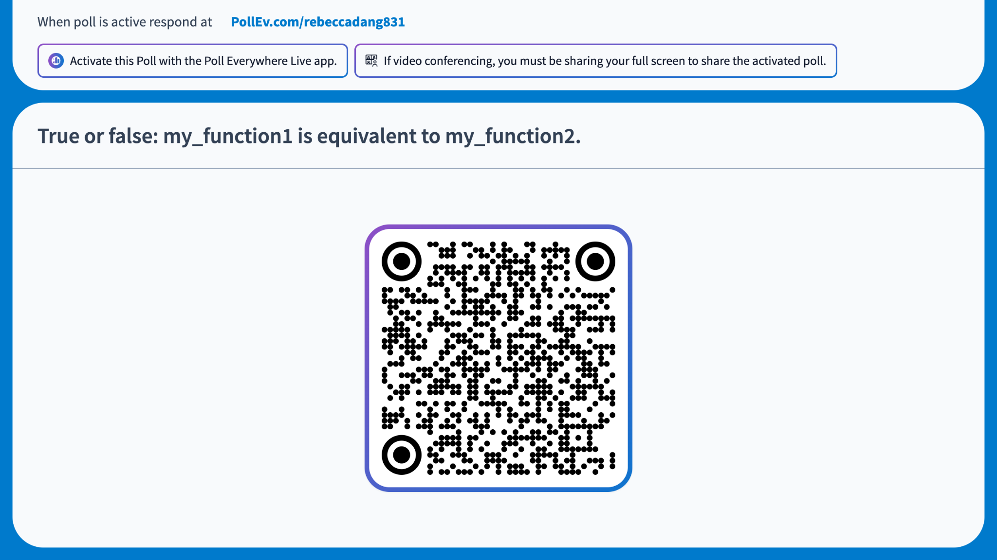
Notes:
https://PollEv.com/multiple_choice_polls/obaFps7XuwWV4zak8HkDQ/respond
True or false: my_function1 is equivalent to my_function2.
def my_function1(x):
if x > 5:
return "A"
return "B"
def my_function2(x):
if x > 5:
return "A"
else:
return "B"
True
False
Answer: (a)

Slide 25
5 min break

Slide 26
Iteration
While loop
Infinite loop
Practice
30 min

Slide 27
While loop
Motivation: What if I want to repeat a set of statements multiple times?
  (Naive) solution: Copy and paste the code blocks
  (Better) solution: Use iteration or loops
While loops are a certain kind of iterative statement:
  While some boolean condition is true, execute everything in the body of the loop
while <condition>:
<suite>

Slide 28
Demo: Add all integers from 1 to 100
>>> i = 1
>>> total = 0
>>> while i <= 100:
... total += i
...
<runs forever, infinite loop>
>>> i = 1
>>> total = 0
>>> while i <= 100:
... total += i
... i += 1
...
>>> total
5050

Slide 29
Demo: Alternate solutions
>>> i = 1
>>> total = 0
>>> while i < 101:
... total += i
... i += 1
...
>>> total
5050
>>> i = 100
>>> total = 0
>>> while i > 0:
... total += i
... i -= 1
...
>>> total
5050

Slide 30
Practice: Add All Even Div Three
Implement a function add_all_even_div_three which takes a positive integer n and returns the sum of all even numbers from 1 to n that are also divisible by 3
Download starter code 02.py from the course website under Lecture 2
Run doctests with python3 -m doctest 02.py
5 min: Try implementing it yourself
5 min: Discuss with someone next to you and compare your implementations
  What worked?
  What didn't?
  Why?

Slide 31
Practice: Fizz Buzz
Implement a function fizzbuzz which takes a positive integer n and prints the numbers from 1 to n, replacing:
  Multiples of 3 with "fizz"
  Multiples of 5 with "buzz", and
  Multiples of both with "fizzbuzz"
Download starter code 02.py from the course website under Lecture 2
Run doctests with python3 -m doctest 02.py
5 min: Try implementing it yourself
5 min: Discuss with someone next to you and compare your implementations
  What worked?
  What didn't?
  Why?
Notes:
Demo ordering of conditions causing test pass vs. failure

Slide 32
Practice: Sum Digits (Lab 01 Q10)
Implement a function sum_digits which takes a positive integer n and returns the sum of the digits of n
Download starter code 02.py from the course website under Lecture 2
Run doctests with python3 -m doctest 02.py
5 min: Try implementing it yourself
5 min: Discuss with someone next to you and compare your implementations
  What worked?
  What didn't?
  Why?

